Slide 1
A Brief Introduction to Group Theory
Insight: It’s all about symmetry.
Notes:
Useful link:
http://symmetry.otterbein.edu/tutorial/index.html (Try BrF5, rotate it around for a good look)

Slide 2
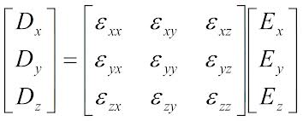
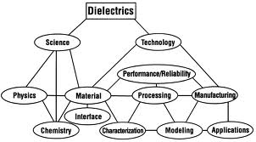
Why Group Theory?
Many complicated measurable quantities depend on the symmetry. The 3x3 dielectric tensor $ε$_{ij} consists of 6 independent components.
Notes:
Can discuss tensors in stress/strain lecture, so not sure want to get into it here (there is time for a 75 minute class)
Rank 0 tensor is a scalar
Rank 1 tensor is a vector
Rank 2 tensor is a matrix (for example, a 3 by 3 matrix like the dielectric tensor above)
Rank 3 gets hard to show in matrix form (for example, a 3 by 3 by 3)
We will also talk about a rank 4 tensor in a class soon. (3x3x3x3, so 81 elements)

Slide 3
Why Group Theory?
Many complicated measurable quantities depend on the symmetry. The 3x3 dielectric tensor $ε$_{ij} consists of 6 independent components.
Crystal symmetry can further reduce the number of independent quantities.
Notes:
Can discuss tensors in stress/strain lecture, so not sure want to get into it here (there is time for a 75 minute class)
Rank 0 tensor is a scalar
Rank 1 tensor is a vector
Rank 2 tensor is a matrix (for example, a 3 by 3 matrix like the dielectric tensor above)
Rank 3 gets hard to show in matrix form (for example, a 3 by 3 by 3)
We will also talk about a rank 4 tensor in a class soon. (3x3x3x3, so 81 elements)

Slide 4
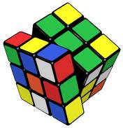
Why Group Theory?
Many complicated measurable quantities depend on the symmetry. The 3x3 dielectric tensor $ε$_{ij} consists of 6 independent components.
Crystal symmetry can further reduce the number of independent quantities.
symmetry
https://www.youtube.com/watch?reload=9&v=FW2Hvs5WaRY
Notes:
Can discuss tensors in stress/strain lecture, so not sure want to get into it here (there is time for a 75 minute class)
Rank 0 tensor is a scalar
Rank 1 tensor is a vector
Rank 2 tensor is a matrix (for example, a 3 by 3 matrix like the dielectric tensor above)
Rank 3 gets hard to show in matrix form (for example, a 3 by 3 by 3)
We will also talk about a rank 4 tensor in a class soon. (3x3x3x3, so 81 elements)

Slide 5
Point Symmetry
An object is symmetric if it is left invariant by a transformation, i.e., cannot be distinguished before and after transformation.
Notes:
For undergraduates: Write H * psi = E * psi on board and remind the meaning of the wavefunction

Slide 6
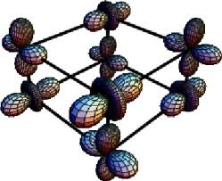
Point Symmetry
An object is symmetric if it is left invariant by a transformation, i.e., cannot be distinguished before and after transformation.
Each of the Bravais lattices has one or more types of symmetry properties
Notes:
For undergraduates: Write H * psi = E * psi on board and remind the meaning of the wavefunction

Slide 7
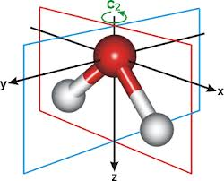
Point Symmetry
An object is symmetric if it is left invariant by a transformation, i.e., cannot be distinguished before and after transformation.
Each of the Bravais lattices has one or more types of symmetry properties
Point symmetry also occurs in molecules
Notes:
For undergraduates: Write H * psi = E * psi on board and remind the meaning of the wavefunction

Slide 8
Symmetry and the Hamiltonian
Makes no difference if symmetry operation occurs before or after Hamiltonian (aka, it commutes w/H)
How this all relates to Quantum Mechanics. You don’t need to have had it yet, but this hints at why this is important.

Slide 9
Symmetry and the Hamiltonian
Makes no difference if symmetry operation occurs before or after Hamiltonian (aka, it commutes w/H)
Quantum mechanics tells us that commuting operators (ex. P) have a common set of eigenstates:
is also an eigenstate of H
How this all relates to Quantum Mechanics. You don’t need to have had it yet, but this hints at why this is important.

Slide 10
Symmetry and the Hamiltonian
Makes no difference if symmetry operation occurs before or after Hamiltonian (aka, it commutes w/H)
Quantum mechanics tells us that commuting operators (ex. P) have a common set of eigenstates:
Therefore it’s possible to classify eigenvalues of the Hamiltonian with respect to symmetry operations
So?
is also an eigenstate of H

Slide 11
Examples of Symmetry Ease
The calculation of eigenfunctions (i.e., diagonalization of a Hamiltonian) can be hard.

Slide 12
Examples of Symmetry Ease
The calculation of eigenfunctions (i.e., diagonalization of a Hamiltonian) can be hard.
Can be much easier if you restrict yourself to wave functions of the correct symmetry.

Slide 13
Examples of Symmetry Ease
The calculation of eigenfunctions (i.e., diagonalization of a Hamiltonian) can be hard.
Can be much easier if you restrict yourself to wave functions of the correct symmetry.
Example 1: Atom invariant under arbitrary rotations, L_{z} and L², leads to spherical harmonics!

Slide 14
Examples of Symmetry Ease
The calculation of eigenfunctions (i.e., diagonalization of a Hamiltonian) can be hard.
Can be much easier if you restrict yourself to wave functions of the correct symmetry.
Example 1: Atom invariant under arbitrary rotations, L_{z} and L², leads to spherical harmonics!
Let m₁=m₂

Slide 15
Examples of Symmetry Ease
The calculation of eigenfunctions (i.e., diagonalization of a Hamiltonian) can be hard.
Can be much easier if you restrict yourself to wave functions of the correct symmetry.
Example 1: Atom invariant under arbitrary rotations, L_{z} and L², leads to spherical harmonics!
Example 2: Simplify vibrational problem, invariant under inversion means ±1 eigenfunctions
Let m₁=m₂

Slide 16
Examples of Symmetry Ease
Start with the Basics
The calculation of eigenfunctions (i.e., diagonalization of a Hamiltonian) can be hard.
Can be much easier if you restrict yourself to wave functions of the correct symmetry.
Example 1: Atom invariant under arbitrary rotations, L_{z} and L², leads to spherical harmonics!
Example 2: Simplify vibrational problem, invariant under inversion means ±1 eigenfunctions
Let m₁=m₂

Slide 17
What is a line of symmetry?
A line on which a figure can be folded so that both sides match.
The two halves must match exactly.
Notes:
Have them make a snowflake.

Slide 18
What is a line of symmetry?
A line on which a figure can be folded so that both sides match.
The two halves must match exactly.
When you trace half a heart onto a piece of folded paper,
and then cut it out, the two half hearts make a whole heart.
Notes:
Have them make a snowflake.

Slide 19
What is a line of symmetry?
A line on which a figure can be folded so that both sides match.
The two halves must match exactly.
When you trace half a heart onto a piece of folded paper,
and then cut it out, the two half hearts make a whole heart.
The two halves are symmetrical.
Notes:
Have them make a snowflake.

Slide 20
Which of these flags have a line of symmetry?
No
United States of America
Canada
No
Maryland
England
Notes:
Some people have trouble seeing that the rectangles don’t work along the diagonal.
Could draw rectangle on the board with the diagonal along the vertical. That will make it clear that the reflection is not the same.
While it’s tough to see, the Maryland flag also does not have rotational symmetry. Note the switch of yellow and black colors if you rotate.

Slide 21
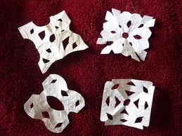
Let’s Make a Snowflake and Identify the Lines of Symmetry
A few different ways to make snowflakes and the method affects the number of lines.
Notes:
Lines of symmetry are along the folds that go from the center to the outside. Most people will make this kind of snowflake with 4 lines of symmetry, though there are always people trying to do something different.

Slide 22
How many lines of symmetry do these polygons have? (equal side lengths)

Slide 23
How many lines of symmetry do these polygons have? (equal side lengths)
3

Slide 24
How many lines of symmetry do these polygons have? (equal side lengths)
3
4
Do you see a pattern?

Slide 25
How many lines of symmetry do these polygons have? (equal side lengths)
4
5
3
Do you see a pattern?
6
8

Slide 26
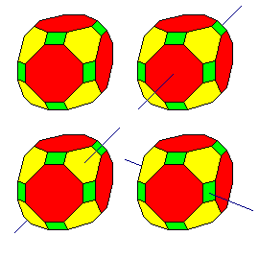
In 3D: Reflection (Mirror in 2D) Plane
A plane in a cell such that, when a mirror reflection in this plane is performed (e.g., x’=-x, y’=y, z’=z), the cell remains invariant.

Slide 27
In 3D: Reflection (Mirror in 2D) Plane
A plane in a cell such that, when a mirror reflection in this plane is performed (e.g., x’=-x, y’=y, z’=z), the cell remains invariant.
Mirror plane indicated by symbol m or σ

Slide 28
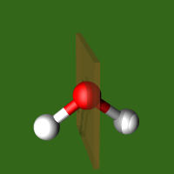
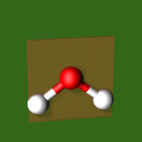
In 3D: Reflection (Mirror in 2D) Plane
A plane in a cell such that, when a mirror reflection in this plane is performed (e.g., x’=-x, y’=y, z’=z), the cell remains invariant.
Mirror plane indicated by symbol m or σ
Example: water molecule has two mirror symmetries
σ_{v} (xz)
σ_{v} (yz)

Slide 29
Mirror Planes in 3D
[001]
[010]
[010]
[100]
[100]
[001]
How many mirror planes are in a cube?
Note how one can re-label the axes but leave the physical object (crystal) unchanged.
Notes:
3+2*3=9 The three are the 100, 010 and 001 planes. Then you have the different diagonals.
Note other symmetry as well, such as rotations.
This rotation shows rotating the cube forward 90 degrees around horizontal, and then ccw 90 degrees around vertical

Slide 30
Matrix Representation of Mirror Planes
Notes:
If time try mirror along diagonal. Take an (x,y) point such that one is much larger than the other so it’s obvious what is happening. I suggest x >> y.
Consider these points like the atoms in your basis. You should also have an atom where you reflect if you have this symmetry.
What happens if you have symmetry along both diagonals? (This leads into the power of group theory slide well, don’t separate them)

Slide 31
Matrix Representation of Mirror Planes Depends on where the plane is
Notes:
If time try mirror along diagonal. Take an (x,y) point such that one is much larger than the other so it’s obvious what is happening. I suggest x >> y.
Consider these points like the atoms in your basis. You should also have an atom where you reflect if you have this symmetry.
What happens if you have symmetry along both diagonals? (This leads into the power of group theory slide well, don’t separate them)

Slide 32
Matrix Representation of Mirror Planes Depends on where the plane is
Notes:
If time try mirror along diagonal. Take an (x,y) point such that one is much larger than the other so it’s obvious what is happening. I suggest x >> y.
Consider these points like the atoms in your basis. You should also have an atom where you reflect if you have this symmetry.
What happens if you have symmetry along both diagonals? (This leads into the power of group theory slide well, don’t separate them)

Slide 33
Matrix Representation of Mirror Planes Depends on where the plane is
Notes:
If time try mirror along diagonal. Take an (x,y) point such that one is much larger than the other so it’s obvious what is happening. I suggest x >> y.
Consider these points like the atoms in your basis. You should also have an atom where you reflect if you have this symmetry.
What happens if you have symmetry along both diagonals? (This leads into the power of group theory slide well, don’t separate them)

Slide 34
Matrix Representation of Mirror Planes
What if the mirror is along the diagonal?
Notes:
(1, -1) goes to (-1,1)
If time try mirror along diagonal. Take an (x,y) point such that one is much larger than the other so it’s obvious what is happening. I suggest x >> y.
Consider these points like the atoms in your basis. You should also have an atom where you reflect if you have this symmetry.
What happens if you have symmetry along both diagonals? (This leads into the power of group theory slide well, don’t separate them)

Slide 35
Matrix Representation of Mirror Planes
What happens if you have both the horizontal and vertical mirrors?
Notes:
Groups, note get all 4 points
If time try mirror along diagonal. Take an (x,y) point such that one is much larger than the other so it’s obvious what is happening. I suggest x >> y.
Consider these points like the atoms in your basis. You should also have an atom where you reflect if you have this symmetry.
What happens if you have symmetry along both diagonals? (This leads into the power of group theory slide well, don’t separate them)

Slide 36
The power of group theory is by combining the different operations which form a group
What happens if you have both the horizontal and vertical mirrors?

Slide 37
The power of group theory is by combining the different operations which form a group
Motif: the fundamental part of a symmetric design that, when repeated, creates the whole pattern (such as a unit cell)

Slide 38
The power of group theory is by combining different operations which form a group
Motif: the fundamental part of a symmetric design that, when repeated, creates the whole pattern
Operation: some act that reproduces the motif to create the pattern

Slide 39
The power of group theory is by combining different operations which form a group
Motif: the fundamental part of a symmetric design that, when repeated, creates the whole pattern
Operation: some act that reproduces the motif to create the pattern
Element: describes the type of operation and where it occurs

Slide 40
What are the motif and operation?
Motif: the fundamental part of a symmetric design that, when repeated, creates the whole pattern
Operation: some act that reproduces the motif to create the pattern
Element: describes the type of operation and where it occurs
A Symmetrical Pattern
6
6

Slide 41
What are the motif and operation?
Motif: the fundamental part of a symmetric design that, when repeated, creates the whole pattern
Operation: some act that reproduces the motif to create the pattern
Element: describes the type of operation and where it occurs
A Symmetrical Pattern
6
Motif
6

Slide 42
What are the motif and operation?
Rotation through an angle about a certain axis
Operation
a. Two-fold rotation
= 360º/2 rotation
to reproduce a motif in a symmetrical pattern
A Symmetrical Pattern
6
Motif
6

Slide 43
Practice: 2-D Symmetry
Operation
a. Two-fold rotation
= 360º/2 rotation
to reproduce a motif in a symmetrical pattern
= the symbol for a two-fold rotation
6
Motif
Element
(located at the point of rotation)
6

Slide 44
2-D Symmetry
a. Two-fold rotation
= 360º/2 rotation
to reproduce a motif in a symmetrical pattern
= the symbol for a two-fold rotation
6
first operation step
second operation step
6

Slide 45
2-D Symmetry
b. Three-fold rotation
= 360º/3 rotation
to reproduce a motif in a symmetrical pattern
6
6
6

Slide 46
2-D Symmetry
b. Three-fold rotation
= 360º/3 rotation
to reproduce a motif in a symmetrical pattern
6
step 1
6
step 3
6
step 2

Slide 47
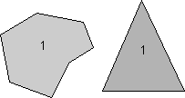
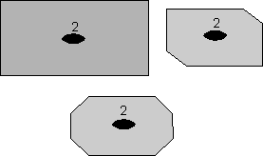
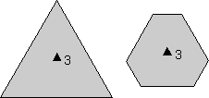
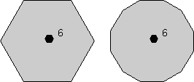
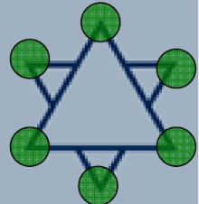
Rotation Axes
Trivial case is 360º rotation
Order of rotation: 2-, 3-, 4-, and 6- correspond to 180º, 120º, 90º, and 60º.
These are only symmetry rotations allowed in crystals with long-range order
Small aggregates (short-range order) or molecules can also have 5-, 7-, etc. fold rotational symmetry
Rotational Symmetry Link
http://www.staff.ncl.ac.uk/j.p.goss/symmetry/Molecules_pov.html

Slide 48
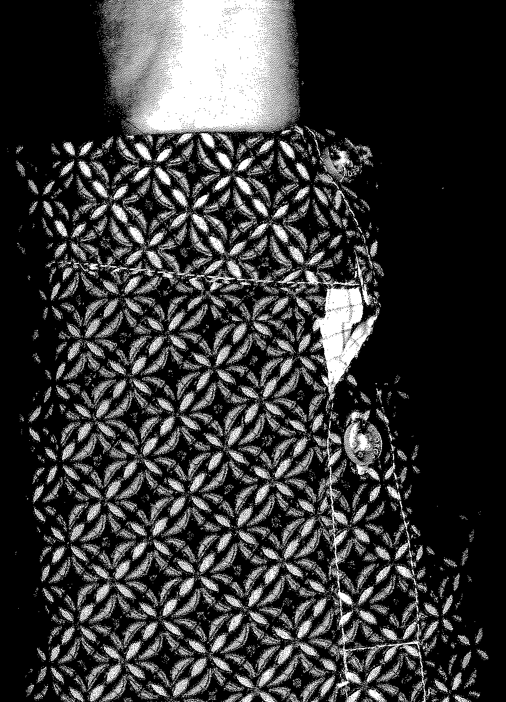
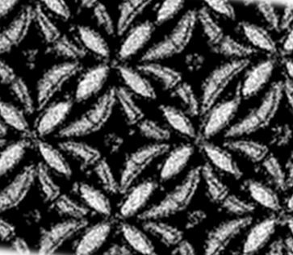
Ignore imperfections from my copy job. Consider imperfections like defects.
Group Exercise
Identify the mirror planes and rotation of the pattern on my shirt.
Notes:
Before stretching: 4 mirror lines, 4 fold rotation
After stretching: 2 mirror lines, 2 fold rotation

Slide 49
Ignore imperfections from my copy job. Consider imperfections like defects.
Group Exercise
Rotated the picture 90 degrees
Identify the mirror planes and rotation of the pattern on my shirt.
Notes:
Before stretching: 4 mirror lines, 4 fold rotation
After stretching: 2 mirror lines, 2 fold rotation

Slide 50
Ignore imperfections from my copy job.
Group Exercise
Identify the mirror planes and rotation of the pattern on my shirt.
How does the pattern sym. change if I stretch?
Notes:
Before stretching: 4 mirror lines, 4 fold rotation
After stretching: 2 mirror lines, 2 fold rotation

Slide 51
Ignore imperfections from my copy job.
Group Exercise
How does the pattern sym. change if I stretch?
Notes:
Before stretching: 4 mirror lines, 4 fold rotation
After stretching: 2 mirror lines, 2 fold rotation

Slide 52
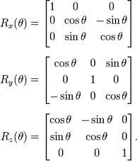
Rotation Representation What about the sign?

Slide 53
Rotation Representation What about the sign?
For example:
Rotate about x by 180 degrees

Slide 54
Rotation Representation What about the sign?
Rotate about x by 180 degrees
Cos(180)=-1
Sine(180)=0
Compare to reflection matrix.

Slide 55
Rotation Representation What about the sign?
Rotate about x by 180 degrees
Cos(180)=-1
Sine(180)=0
Compare to reflection matrix.
Angles ≠ 180° very different.

Slide 56
Inversion Center
Center of symmetry: A point at the center of a molecule.
(x,y,z) --> (-x,-y,-z)
It is not necessary to have an atom in the center (benzene, ethane).
Tetrahedral, triangles, pentagons do not have a center of inversion symmetry.
All Bravais lattices are inversion symmetric.
Once you add the basis, this symmetry may be lost.
Mo(CO)6
Notes:
Draw triangle on board. Then draw upside down; not the same.
For example, could discuss BaTiO3 with displaced center ion but lattice is inversion symmetric.

Slide 57
2-D Symmetry
Symmetry Elements
2. Inversion (i)
inversion through a center to reproduce a motif in a symmetrical pattern
= symbol for an inversion center
Inversion is identical to 2-fold rotation in 2-D, but is unique in 3-D
6
6

Slide 58
Last 2D Symmetry Element
Symmetry Elements
3. Reflection (m)
Reflection across a “mirror plane” reproduces a motif
= symbol for a mirror
plane

Slide 59
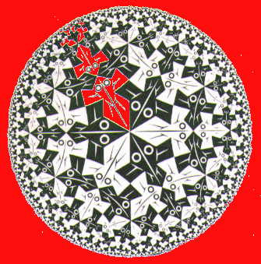
Crystal Symmetry
(Escher, Circle limit I)
We now have 6 unique 2-D symmetry operations: 1 2 3 4 6 m
(inversion not unique in 2D)

Slide 60
Crystal Symmetry
(Escher, Circle limit I)
We now have 6 unique 2-D symmetry operations: 1 2 3 4 6 m (inversion not unique)
Combinations of symmetry elements are also possible

Slide 61
Crystal Symmetry
(Escher, Circle limit I)
We now have 6 unique 2-D symmetry operations: 1 2 3 4 6 m (inversion not unique)
Combinations of symmetry elements are also possible
The group of operations that can map a crystal into itself defines the crystal symmetry

Slide 62
Crystal Symmetry
(Escher, Circle limit I)
We now have 6 unique 2-D symmetry operations: 1 2 3 4 6 m (inversion not unique)
Combinations of symmetry elements are also possible
The group of operations that can map a crystal into itself defines the crystal symmetry
Groups with lots of operations have high symmetry

Slide 63
Crystal Symmetry
(Escher, Circle limit I)
We now have 6 unique 2-D symmetry operations: 1 2 3 4 6 m (inversion not unique)
Combinations of symmetry elements are also possible
The group of operations that can map a crystal into itself defines the crystal symmetry
Groups with lots of operations have high symmetry
In the interest of clarity and ease of illustration, let’s start with 2-D examples

Slide 64
2-D Symmetry
Try combining a 2-fold rotation axis with a mirror

Slide 65
2-D Symmetry
Try combining a 2-fold rotation axis with a mirror
Step 1: reflect
(could do either step first)

Slide 66
2-D Symmetry
Try combining a 2-fold rotation axis with a mirror
Step 1: reflect
Step 2: rotate (everything)
Is that all??

Slide 67
2-D Symmetry
Try combining a 2-fold rotation axis with a mirror
Step 1: reflect
Step 2: rotate (everything)
Is that all??
No! A second mirror is required

Slide 68
2-D Symmetry
Try combining a 2-fold rotation axis with a mirror
The result is Point Group 2mm
“2mm” indicates 2 mirrors
The mirrors are different
(not equivalent by symmetry)

Slide 69
2-D Symmetry
3-fold rotation axis with a mirror
Guess the point group.
Point group 3m
Why not 3mmm?

Slide 70
2-D Symmetry
Now try combining a 4-fold rotation axis with a mirror

Slide 71
2-D Symmetry
Now try combining a 4-fold rotation axis with a mirror
Step 1: reflect

Slide 72
2-D Symmetry
Now try combining a 4-fold rotation axis with a mirror
Step 1: reflect
Step 2: rotate 1

Slide 73
2-D Symmetry
Now try combining a 4-fold rotation axis with a mirror
Step 1: reflect
Step 2: rotate 2

Slide 74
2-D Symmetry
Now try combining a 4-fold rotation axis with a mirror
Step 1: reflect
Step 2: rotate 3
Any other elements?

Slide 75
2-D Symmetry
Now try combining a 4-fold rotation axis with a mirror
Any other elements?
Yes, two more mirrors
Point group name??

Slide 76
2-D Symmetry
Now try combining a 4-fold rotation axis with a mirror
Any other elements?
Yes, two more mirrors
Point group name??
4mm
Why not 4mmmm?

Slide 77
2-D Symmetry
6-fold rotation axis with a mirror creates ???

Slide 78
2-D Symmetry
6-fold rotation axis with a mirror creates ???
Any other elements?

Slide 79
2-D Symmetry
6-fold rotation axis with a mirror creates ???
Point group name??

Slide 80
2-D Symmetry
6-fold rotation axis with a mirror creates ???
point group 6mm

Slide 81
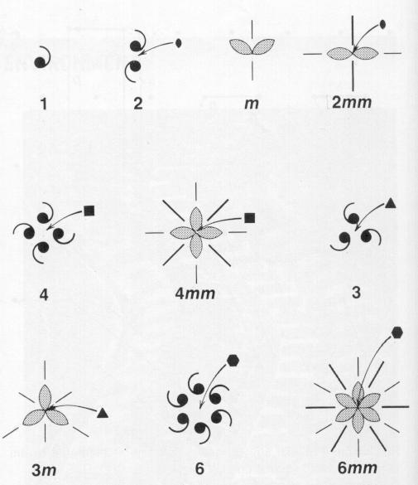
2-D Symmetry
The original 6 elements plus the 4 combinations creates 10 possible 2-D Point Groups:
1 2 3 4 6 m 2mm 3m 4mm 6mm
Any repeating 2-D pattern of objects surrounding a point must conform to one of these groups
dark lines added “found mirrors”

Slide 82
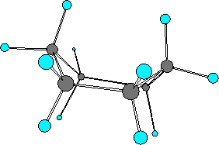
Example: Water
What symmetry elements does water possess?
Used in the production of nylon and in some cleaning products
Cyclohexane (C₆H₁₂) in the boat conformation has same 2mm (or C_{2v} ) symmetry
σ_{v} (xz)
σ_{v} (yz)
Notes:
Identity
Known as C2v in Sch. Notation
Cyclohexane is mainly used for the industrial production of adipic acid and caprolactam, which are precursors to nylon. Cyclohexane is a colourless, flammable liquid with a distinctive detergent-like odor, reminiscent of cleaning products (in which it is sometimes used).

Slide 83
Let’s Identify the Point Group of Your Snowflake
A few different ways to make snowflakes and the method affects the number of lines.

Slide 84
2D vs 3D
In 2D, have 6 unique symmetry operations:
1 2 3 4 6 m (inversion not unique)
2D has 10 point groups: 1 2 3 4 6 m 2mm 3m 4mm 6mm
In 3D, inversion is unique
Now 7 symmetry operations (but wait, there’s more)
Every crystal described by a combination of point-symmetry elements

Slide 85
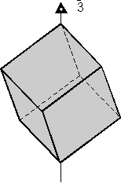
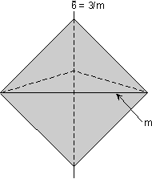
Rotation-inversion Axes
Combination of simultaneous rotation and inversion results in new symmetry element
International symbol representation:
This operation involves a rotation by (360/3) ° followed by an inversion through the center of the object.
These are a lot harder to visualize. It takes some practice.

Slide 86
Symmetry operations
Schoenflies Terminology
E | The identity transformation
C_{n} | Rotation (clockwise) through an angle of 2π/n radians, where n is an integer.
S_{n} | An improper rotation (clockwise) through an angle of 2π/n radians. Improper rotations are regular rotations followed by a reflection in the plane perpendicular to the axis of rotation. Also known as alternating axis of symmetry and rotation-reflection axis.
i | The inversion operator (the same as S₂). In Cartesian coordinates, (x, y, z)→(−x, −y, −z). Irreducible representations that are even under this symmetry operation are usually denoted with the subscript g, and those that are odd are denoted with the subscript u.
σ | A mirror plane
σ_{h} | Horizontal reflection plane
σ_{v} | Vertical reflection plane
σ_{d} | Diagonal reflection in a plane through the origin.
http://www.staff.ncl.ac.uk/j.p.goss/symmetry/CharacterTables.html

Slide 87
Symmetry operations
Two Main Types of Symmetry Terminology
E | The identity transformation
C_{n} | Rotation (clockwise) through an angle of 2π/n radians, where n is an integer.
S_{n} | An improper rotation (clockwise) through an angle of 2π/n radians. Improper rotations are regular rotations followed by a reflection in the plane perpendicular to the axis of rotation. Also known as alternating axis of symmetry and rotation-reflection axis.
i | The inversion operator (the same as S₂). In Cartesian coordinates, (x, y, z)→(−x, −y, −z). Irreducible representations that are even under this symmetry operation are usually denoted with the subscript g, and those that are odd are denoted with the subscript u.
σ | A mirror plane
σ_{h} | Horizontal reflection plane
σ_{v} | Vertical reflection plane
σ_{d} | Diagonal reflection in a plane through the origin.
Element | Schoenflies | Hermann-Mauguin | Operation
Rotation axis | C_{n} | n | n-fold rotation (360º/n)
Identity | E | 1 | nothing
Plane of symmetry | σ | m | Reflection
Center of symmetry | i | -1 | Inversion
Improper rotation axis | S_{n} | - | n-fold rotation + reflection
Rotary Inversion axis | - | -n or “n bar” | n-fold rotation + inversion
http://www.staff.ncl.ac.uk/j.p.goss/symmetry/CharacterTables.html

Slide 88
3-D Symmetry
We now have 10 unique 3-D symmetry operations:
1 2 3 4 6 i m 3 4 6
Combinations of these elements are also possible
A complete analysis of symmetry about a point in space requires that we try all possible combinations of these symmetry elements

Slide 89
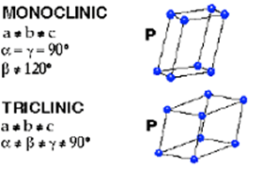
Examples
(Groups) Determine the number of mirror planes.

Slide 90
Examples
(Groups) Determine the number of mirror planes.
Triclinic has no mirror planes.
Monoclinic has one plane midway between and parallel to the bases.

Slide 91
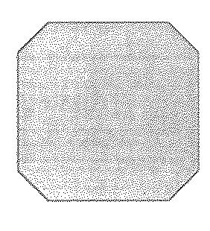
Group Exercise (2D)
Below are two “crystals” and a polygon. Compare to stretched and unstretched shirt pattern.
Identify the point group symmetry operations and group of the objects (assume crystals are of infinite size).
a
b
c
Notes:
M1.1, A and C have eight symmetry elements (4mmm): identity, 90, 180, 270 rotation, four mirrors
In 2D, inversion does not count as it is the same as 180 rotation.
B does not have the mirror planes, and thus cannot be the same point group.

Slide 92
What are the symmetry elements?
Unstretched shirt, a and c, have identity, 4 fold rotation and 4 reflections.
b has no reflections, but identity and 3 rotations
Stretched shirt has identity and 180 rotation, and two reflections planes.
a
b
c
Notes:
A and C have eight symmetry elements (4mmm): identity, 90, 180, 270 rotation, four mirrors
In 2D, inversion does not count as it is the same as 180 rotation.
B does not have the mirror planes, and thus cannot be the same point group.

Slide 93
Glides
There is a new 2-D symmetry operation when we consider translations
The Glide Line, g:
A combined reflection
and translation
(Glide planes in 3D)
repeat
Step 2: translate
Step 1: reflect
(a temporary position)

Slide 94
Understanding Rotoinversion
2-fold rotoinversion
Step 1: rotate 360/2
Note: this is a temporary step, the intermediate motif element does not exist in the final pattern

Slide 95
3-D Symmetry
2-fold rotoinversion ( 2 )
Step 1: rotate 360/2
Step 2: invert

Slide 96
3-D Symmetry
2-fold rotoinversion ( 2 )
The result:

Slide 97
3-D Symmetry
2-fold rotoinversion ( 2 )
This is the same as m, so not a new operation

Slide 98
1 fold rotoinversion also not unique
1-fold rotoinversion ( 1 )
Step 1: rotate 360/1
(identity)
Step 2: invert (x,y,z) ->
(-x,-y,-z)
This is the same as i, so also not a new operation

Slide 99
3-D Symmetry
New Symmetry Elements
4. Rotoinversion
c. 3-fold rotoinversion ( 3 )

Slide 100
3-D Symmetry
New Symmetry Elements
4. Rotoinversion
c. 3-fold rotoinversion ( 3 )
Step 1: rotate 360º/3
Again, this is a temporary step, the intermediate motif element does not exist in the final pattern
1

Slide 101
3-D Symmetry
New Symmetry Elements
4. Rotoinversion
c. 3-fold rotoinversion ( 3 )
Step 2: invert through center

Slide 102
3-D Symmetry
New Symmetry Elements
4. Rotoinversion
c. 3-fold rotoinversion ( 3 )
Completion of the first sequence
1
2

Slide 103
3-D Symmetry
New Symmetry Elements
4. Rotoinversion
c. 3-fold rotoinversion ( 3 )
Rotate another 360/3

Slide 104
3-D Symmetry
New Symmetry Elements
4. Rotoinversion
c. 3-fold rotoinversion ( 3 )
Invert through center

Slide 105
3-D Symmetry
New Symmetry Elements
4. Rotoinversion
c. 3-fold rotoinversion ( 3 )
Complete second step to create face 3
3
1
2

Slide 106
3-D Symmetry
New Symmetry Elements
4. Rotoinversion
c. 3-fold rotoinversion ( 3 )
Third step creates face 4
(3 → (1) → 4)
3
1
4
2

Slide 107
3-D Symmetry
New Symmetry Elements
4. Rotoinversion
c. 3-fold rotoinversion ( 3 )
Fourth step creates face 5 (4 → (2) → 5)
5
1
2

Slide 108
3-D Symmetry
New Symmetry Elements
4. Rotoinversion
c. 3-fold rotoinversion ( 3 )
Fifth step creates face 6
(5 → (3) → 6)
Sixth step returns to face 1
5
1
6

Slide 109
3-D Symmetry
New Symmetry Elements
4. Rotoinversion
c. 3-fold rotoinversion ( 3 )
This is unique
3
5
1
4
2
6

Slide 110
3-D Symmetry
New Symmetry Elements
4. Rotoinversion
e. 6-fold rotoinversion ( 6 )
Begin with this framework:

Slide 111
3-D Symmetry
New Symmetry Elements
4. Rotoinversion
e. 6-fold rotoinversion ( 6 )
1

Slide 112
3-D Symmetry
New Symmetry Elements
4. Rotoinversion
e. 6-fold rotoinversion ( 6 )
1

Slide 113
3-D Symmetry
New Symmetry Elements
4. Rotoinversion
e. 6-fold rotoinversion ( 6 )
1
2

Slide 114
3-D Symmetry
New Symmetry Elements
4. Rotoinversion
e. 6-fold rotoinversion ( 6 )
1
2

Slide 115
3-D Symmetry
New Symmetry Elements
4. Rotoinversion
e. 6-fold rotoinversion ( 6 )
1
3
2

Slide 116
3-D Symmetry
New Symmetry Elements
4. Rotoinversion
e. 6-fold rotoinversion ( 6 )
1
3
2

Slide 117
3-D Symmetry
New Symmetry Elements
4. Rotoinversion
e. 6-fold rotoinversion ( 6 )
1
3
2
4

Slide 118
3-D Symmetry
New Symmetry Elements
4. Rotoinversion
e. 6-fold rotoinversion ( 6 )
1
3
2
4

Slide 119
3-D Symmetry
New Symmetry Elements
4. Rotoinversion
e. 6-fold rotoinversion ( 6 )
1
3
5
2
4

Slide 120
3-D Symmetry
New Symmetry Elements
4. Rotoinversion
e. 6-fold rotoinversion ( 6 )
1
3
5
2
4

Slide 121
3-D Symmetry
New Symmetry Elements
4. Rotoinversion
e. 6-fold rotoinversion ( 6 )
1
3
5
2
6
4

Slide 122
3-D Symmetry
New Symmetry Elements
4. Rotoinversion
e. 6-fold rotoinversion ( 6 )
Note: this is the same as a 3-fold rotation axis perpendicular to a mirror plane
(combinations of elements follows)
Top View

Slide 123
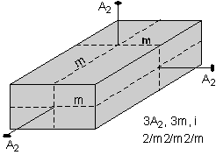
Hermann-Mauguin Symbols
To begin, write a number representing each of the unique rotation axes present.
A unique rotation axis is one that exists by itself and is not produced by another symmetry operation.
In this case, all three 2-fold axes are unique, because each is perpendicular to a different shaped face, so we write a 2 (for 2-fold) for each axis, A:
2 2 2

Slide 124
Hermann-Mauguin Symbols
Next we write an "m" for each unique mirror plane.
Again, a unique mirror plane is one that is not produced by any other symmetry operation.
In this example, we can tell that each mirror is unique because each one cuts a different looking face. So, we write:
2 m 2 m 2 m

Slide 125
3-D Symmetry
3-D symmetry element combinations
a. Rotation axis parallel to a mirror
Same as 2-D
2 || m = 2mm
3 || m = 3m, also 4mm, 6mm
b. Rotation axis ⊥ mirror
2 ⊥ m = 2/m
3 ⊥ m = 3/m, also 4/m, 6/m
c. Most other rotations + m are impossible
2-fold axis at odd angle to mirror?
Some cases at 45º or 30º are possible, as we shall see

Slide 126
3-D Symmetry
3-D symmetry element combinations
d. Combinations of rotations
2 + 2 at 90º → 222 (third 2 required from combination)
4 + 2 at 90º → 422 ( “ “ “ )
6 + 2 at 90º → 622 ( “ “ “ )

Slide 127
3-D Symmetry
As in 2-D, the number of possible combinations is limited only by incompatibility and redundancy
There are only 22 possible unique 3-D combinations, when combined with the 10 original 3-D elements yields the 32 3-D Point Groups

Slide 128
Hermann-Mauguin Symbols
If any of the axes are perpendicular to a mirror plane we put a slash (/) between the symbol for the axis and the symbol for the mirror plane. In this case, each of the 2-fold axes are perpendicular to mirror planes, so our symbol becomes:
2/m 2/m 2/m
The D_{nh} Groups:
Briefly know as, D_{2h} =mmm,
D_{4h} =4/mmm, D_{6h} =6/mmm,

Slide 129
Lattice goes into itself through
Symmetry without translation
Operation | Element
Inversion | Point
Reflection | Plane
Rotation | Axis
Rotoinversion | Axes
The system of symmetry operations
The point group symbol
Or the Schonflies symbol (popular for group theory or spectroscopy)

Slide 130
Symmetry Element Properties (also true for 2D)
Must satisfy conditions:
Two successive symmetry operations result in a further symmetry element: A * B = C
Associative rule: (A*B)*C = A*B*C
Identity element E: A*E = A
Every symmetry element possesses inverse: A⁻¹ *A = E
A*B = B*A
This leads to 32 distinct crystallographic groups
If you were also to allow translations, 7 --> 14, allowing 230 combinations, known as space groups

Slide 131
Invariance to transformation as an indicator of facial symmetry:
Symmetry frequently considered more pleasing.
Mirror image

Slide 132
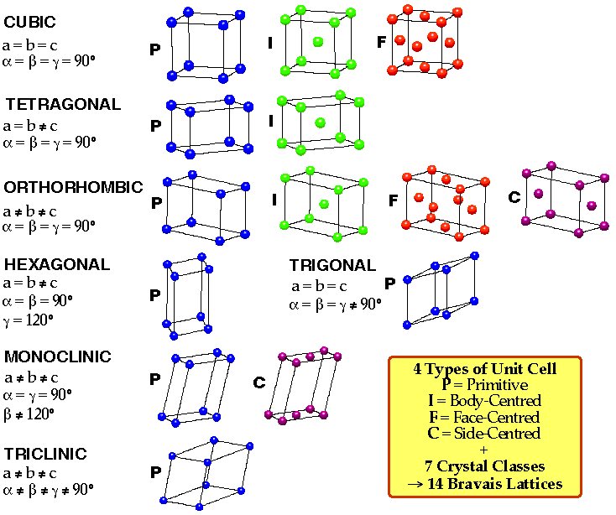
Start on Space Group Notation
The initial letter of a space group symbol represents the lattice type which may primitive (P), single-face centred (A, B, or C), all-face centred (F), body-centred (I), or rhomohedrally centred (R). (For rhomohedral space groups, a primitive unit cell may also be chosen, but the symbol R is still used so as to distinguish these space groups from the primitive trigonal space groups based on hexagonal axes.)
BiFeO₃ is R-3c
Bravais lattices
Notes:
Hermann-Mauguin notation

Slide 133
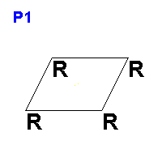
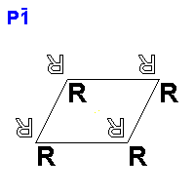
Triclinic is either P-1 or P1
For triclinic systems, the remaining symbol is either 1 or -1 showing the absence or presence of an inversion center, respectively.
Notes:
Hermann-Mauguin notation

Slide 134
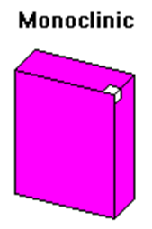
Monoclinic types: P2, Pm, P2/m
After the lattice type (P or C shown), the remaining part of the space group symbol indicates symmetry with respect to the unique axis direction, i.e. axes parallel to the unique axis or planes perpendicular to it.
Note that the short form of the space group symbol omits the two "1"s for the symmetry with respect to the other two axes.
Do more later if time…
General notation (beyond just monoclinic): If any of the axes are perpendicular to a mirror plane we put a slash (/) between the symbol for the axis and the symbol for the mirror plane.
Notes:
Hermann-Mauguin notation
What is unique axis? Looks almost perpendicular to slide.
This starts getting hard to see! I won’t expect you to do this on a test. Mainly want you to be familiar with the notation.

Slide 135
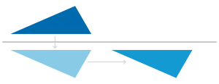
More space group notation: Understanding Glide Planes
Could also have glide planes along b or c or a diagonal (n)
Has mirror symmetry
A mirror rotation followed by a translation is a glide plane
Don’t confuse with defect glide planes, when this happens accidentally

Slide 136
Orthorhombic: Symbol types P222, Pmm2 (or Pm2m or P2mm), Pmmm
After the lattice type, there are three parts to the space group symbol indicating the symmetry with respect to the x, y, and z axis directions, respectively.
For example, the space group symbol Pnma indicates a primitive lattice with an n-glide (diagonal) plane perpendicular to the x axis, a mirror plane perpendicular to the y axis, and an a-glide plane perpendicular to the z axis.
Notes:
Hermann-Mauguin notation

Slide 137
Tetragonal: Symbol types P4, P-4, P4/m, P422, P4mm, P-42m (or P-4m2), P4/mmm.
The tetragonal space groups may be subdivided into two groups: Those with and without additional symmetry with respect to the x and y axes.
The fourfold symmetry is always chosen to lie parallel to the z axis and is specified second in the space group symbol after the lattice type. For those space groups with symmetry along other the other axes, e.g. as in P-42m, the next part of the symbol indicates the symmetry with respect to both the x and y axes. The remaining part of the symbol indicates the symmetry with respect to both of the diagonals between the x and y axes.
Note that for the enlarged tetragonal unit cells, i.e. C or F centred unit cells, the symbols chosen to describe the symmetry with respect to the x and y axes, and with respect to the face-diagonal directions is simply the same as that used for the equivalent P and I centred cells, but with the order of the symbols reversed e.g. the symbol C4/mmb is used for the enlarged unit cell of space group P4/mbm. A more logical symbol in this instance would be C4/mmn.
Notes:
Hermann-Mauguin notation

Slide 138
Other systems
Trigonal & Rhombohedral: Symbol types P3, P-3, P321, P312, P3m1, P31m, P-3m1, P-31m.
The threefold symmetry is always chosen to lie parallel to the z axis and the symbol for it follows the lattice type in the space group symbol. Additional symmetry elements may be lie parallel to the x and y axes (e.g. the twofold rotation axes in P321) or perpendicular to them (e.g. the twofold rotation axes in P312). The order of the last two components of the space group symbol is used to distinguish the two possibilities.
Hexagonal: Symbol types P6, P-6, P6/m, P622, P6mm, P-62m (or P-6m2), P6/mmm.
The order of the symbols in the hexagonal space group symbols is similar to that of the trigonal space group symbols except that the symmetry with respect to the z axis is now of order six.
Cubic: Symbol types P23, Pm-3, P432, P-43m, Pm3m.
The symbols of the cubic space group symbols refer to the lattice type (P, F, or I) followed by symmetry with respect to the x, y, and z axes, then the threefold symmetry of the body diagonals, followed lastly by any symmetry with respect to the face diagonals if present.
Notes:
Hermann-Mauguin notation

